Slide 1


Weather App
Our weather app provides accurate and up-to-date weather information for your location. Use our app to plan your day with confidence, knowing what to expect.
by Priyanshu Dubey

Slide 2


Current Conditions
Temperature
The current temperature is displayed in Celsius or Fahrenheit, depending on your preference.
Weather Description
Detailed descriptions like "Sunny," "Cloudy," "Rainy," or "Snowy" are provided.
Humidity
The percentage of moisture in the air is displayed to give you a sense of how comfortable the weather will feel.
Wind Speed and Direction
The speed and direction of the wind are shown, indicating how windy it is and from which direction the wind is blowing.

Slide 3


Hourly Forecast
1
Next 12 Hours
Hourly weather predictions for the next 12 hours, including temperature, weather conditions, and wind speed.
2
Next 24 Hours
See how the weather will evolve throughout the day, providing valuable information for planning activities.
3
Next 48 Hours
Gives you a comprehensive overview of the weather in the next two days, helping you make informed decisions about your plans.

Slide 4
Daily Forecast
Current Day
Next 7 Days
Weather Icons
A summary of the expected weather for the current day, including high and low temperatures, conditions, and precipitation.
Provides a daily forecast for the next week, outlining the expected weather conditions, temperatures, and precipitation levels.
Visual representations of weather conditions, like sunny, cloudy, rainy, or snowy, enhance understanding and make it easy to grasp the forecast.

Slide 5

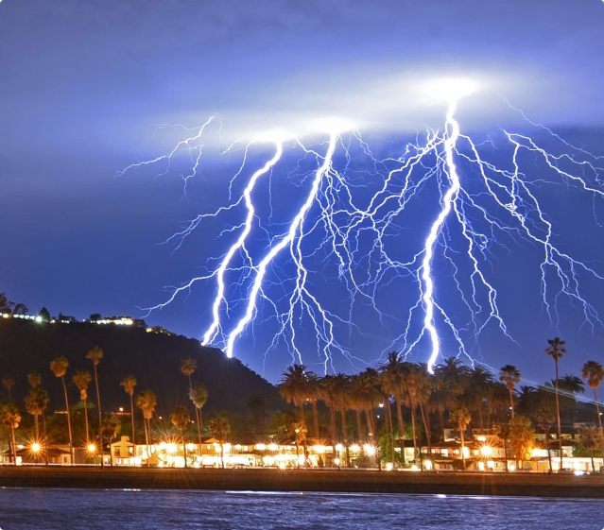
Alerts and Warnings
1
Severe Weather
Alerts for severe weather events such as thunderstorms, heavy rain, snowstorms, or high winds.
2
Extreme Temperatures
Notifications about extreme heat or cold, helping you stay prepared for potentially hazardous conditions.
3
Air Quality
Information about air quality, including levels of pollutants, can be crucial for individuals with respiratory issues.

Slide 6

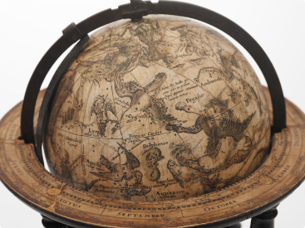



Location Settings
Automatic Location
Manual Location
Save Favorites
The app automatically detects your location using your device's GPS, providing accurate weather information for your current location.
You can manually search for the weather in any location by entering the city or zip code.
Save your favorite locations for quick access to weather information in those specific areas.

Slide 7





Additional Features
Sunrise and Sunset Times
See when the sun rises and sets in your location, providing useful information for planning outdoor activities.
Moon Phases
The moon's current phase and its position in the sky are shown for those who follow lunar cycles.
Widget
Add a widget to your home screen for quick access to current weather conditions without opening the app.

Slide 8


Data Privacy
Location Data
We only collect your location data when you use the app, and we don't store it unless you explicitly choose to save favorite locations.
Personal Information
We don't collect any personal information, such as your name, email address, or phone number.

